Slide 1
Kilmichael Wind Farm, Co. Wexford
SID Pre-Application Consultation Presentation
ACP SID Pre-App Ref. ACP-323955-25
25th June 2026

Slide 2
Ecology
Bats
Surveys have been carried out in accordance with Nature Scot Guidelines.
Levels of Bat Activity around the site are low to moderate generally.
No Bat Roosts within the Zone of Influence.
No Derogation is required.
Ornithology
The Bird surveys were undertaken following NatureScot Guidelines
Surveys undertaken included vantage point watches, breeding bird, dusk and raptor surveys, non-breeding winter walkovers and targeted species surveys, particularly for non-breeding hen harrier and red kite.
Ornithological surveys were conducted between April 2023 to March 2024 (Year 1), March 2024 to March 2025 (Year 2) and consisted of.
  Vantage point
  Breeding bird
  Dusk surveys
  Breeding raptor
  Non-breeding raptor surveys
  Non-breeding walkover surveys
  Non-breeding waterbirds surveys (2023/24 only)
Ornithological surveys on going March- July 2026
  Breeding bird survey GCR + Substation (including dusk surveys).
Mammal
Badger Sett identified to the south west corner of the substation lands. Through the design location of the substation, we have ensured that a setback in incorporates.
Within 75m of the badger sett form substation.
Badger and Pine marten has been identified within the wind farm site.
No otter breeding or resting places found.
FWPM
Freshwater pearl mussel persists in the Slaney River, with populations being located at Enniscorthy c. 30 km downstream of the site boundary.
The Site is hydrologically connected to the River Slaney via tributaries connected to the River Bann.
Despite being recorded downstream, no evidence of FPM was recorded in the 6 no. sites surveyed.
Habitat
No FPO Species identified.
No Annex 1 type Habitats.
Predominately Conifer within the Wind Farm site, and agricultural grassland.
Bridge crossing will be clear span within agricultural lands and will require some riparian habitat removal.

Slide 3
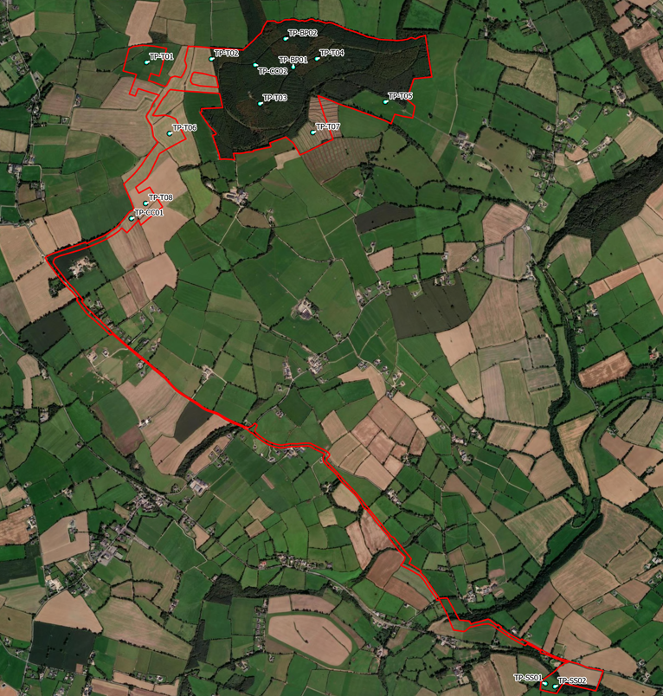
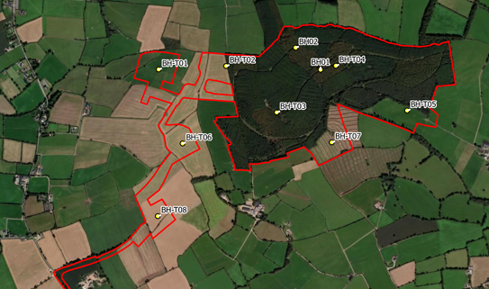
Hydrogeology and Landslide Susceptibility
The site is located within a ‘Poor Aquifer – Bedrock which is generally unproductive except for local zones’
Groundwater vulnerability is classed as predominantly being ‘Rock at or near surface’ or ‘Extreme’. This is expected as rock is shallow across the site
The Quaternary Geology of the site is predominantly ‘Bedrock outcrop or subcrop’ with areas of ‘Till derived from Lower Palaeozoic shales’ also present
The Bedrock Geology of the site is the ‘Ballylane Formation’ which comprises ‘green and grey slate with thin siltstone’
Landslide susceptibility is ‘Low’ to ‘Moderately Low’ across the site with an area of ‘Moderately High’ along a southern section within the Coillte forestry
There have been no historic landslides within the site boundary or close to the site (the closest is about 20km north)
Based on groundwater wells east and west of the site, bedrock was met at 1.8m and 3m respectively. These wells are used for ‘agricultural and domestic use’
A borrow pit is proposed to be located within the Coillte Forestry lands.
Site Investigations are starting first week of July - 14 no. trial pits and 10 no. boreholes are proposed.
The Ground Model will then be prepared following SI works.

Slide 4
Water Quality
Water Quality monitoring ongoing.
Clear-span bridge crossing at Substation Lands is proposed.
No notable hydrological issues have been identified beyond those to be addressed through standard mitigation measures.​
Mitigation to include improved fencing and buffer zones along the riverbank and riparian zone where appropriate, along with provision of drinking troughs, in order to prevent the poaching and bank erosion/destabilisation from livestock and land run off.
The site does not fall within any flood zones.

Slide 5
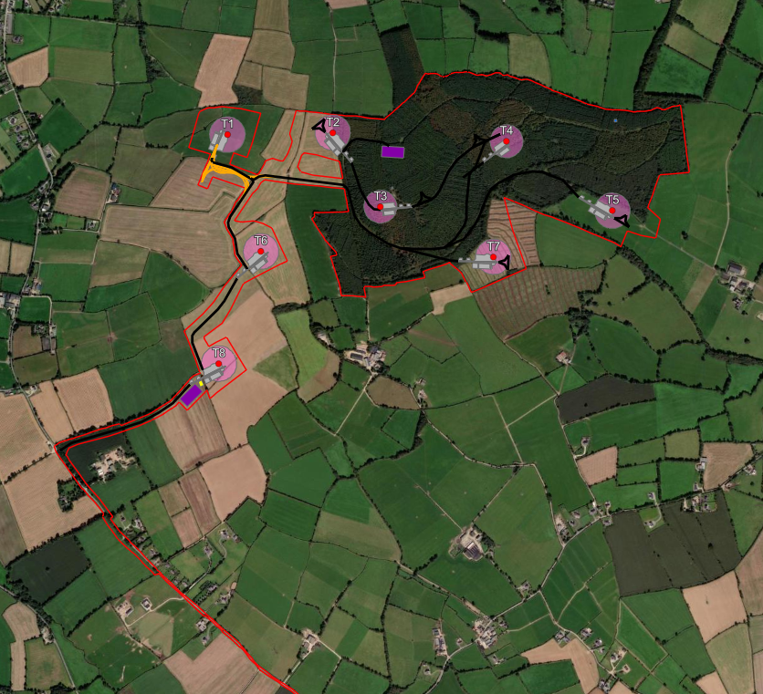
Turbine Model Details
Following our last meeting, we can confirm that we will not be entering into the Design Flexibility Process.
The turbine specification details are set out below.
Turbine Specification
Hub Height | 99m
Tip Height | 180m
Rotor Diameter | 162m
MWs | 7.2MW
Total Site MWs | 57.6MW

Slide 6
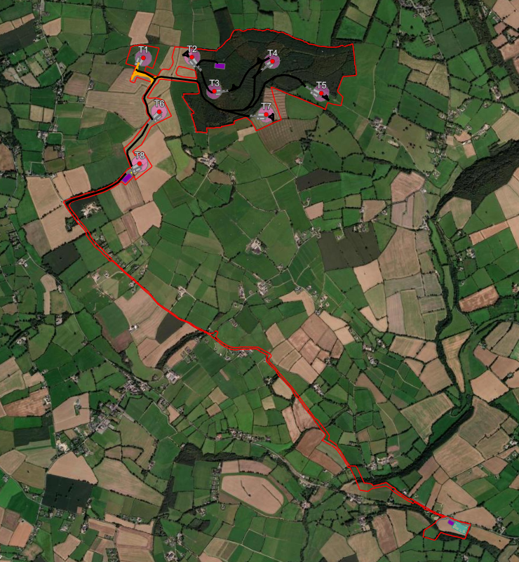
Proposed Grid Connection Route
The final proposed Grid Connection Route comprises a part in-road and part off-road connection route.
Seeking to reduce the quantum of works within the public road.
The proposed Grid Connection Route crossing of the Slaney River Valley SAC will be undertaken by HDD sufficiently setback from the riparian zone.

Slide 7
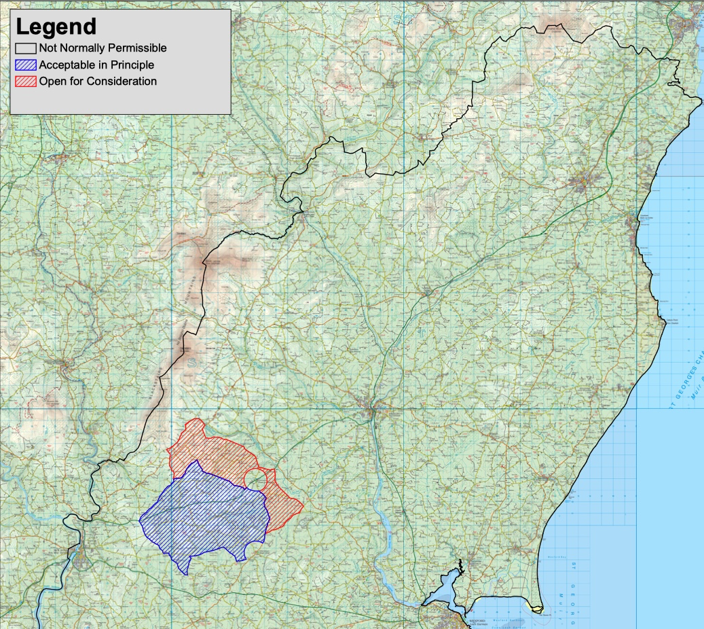

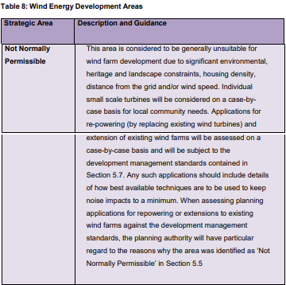
Local Planning Policy
The Wexford County Development Plan 2022-2028 (CDP) came into effect on 25th July 2022.
The ‘Energy Strategy’ (Volume 10 of the CDP) identifies the site within an area classified as “Not Normally Permissible” for wind development. It is important to note that the policy “Not Normally Permissible” for wind energy development does not expressly preclude wind energy in this area, but would generally discourage same.
SITE
Extract of Map 14 - Wind Energy Strategy Map (Vol 10 - Energy Strategy of the Wexford CDP)

Slide 8
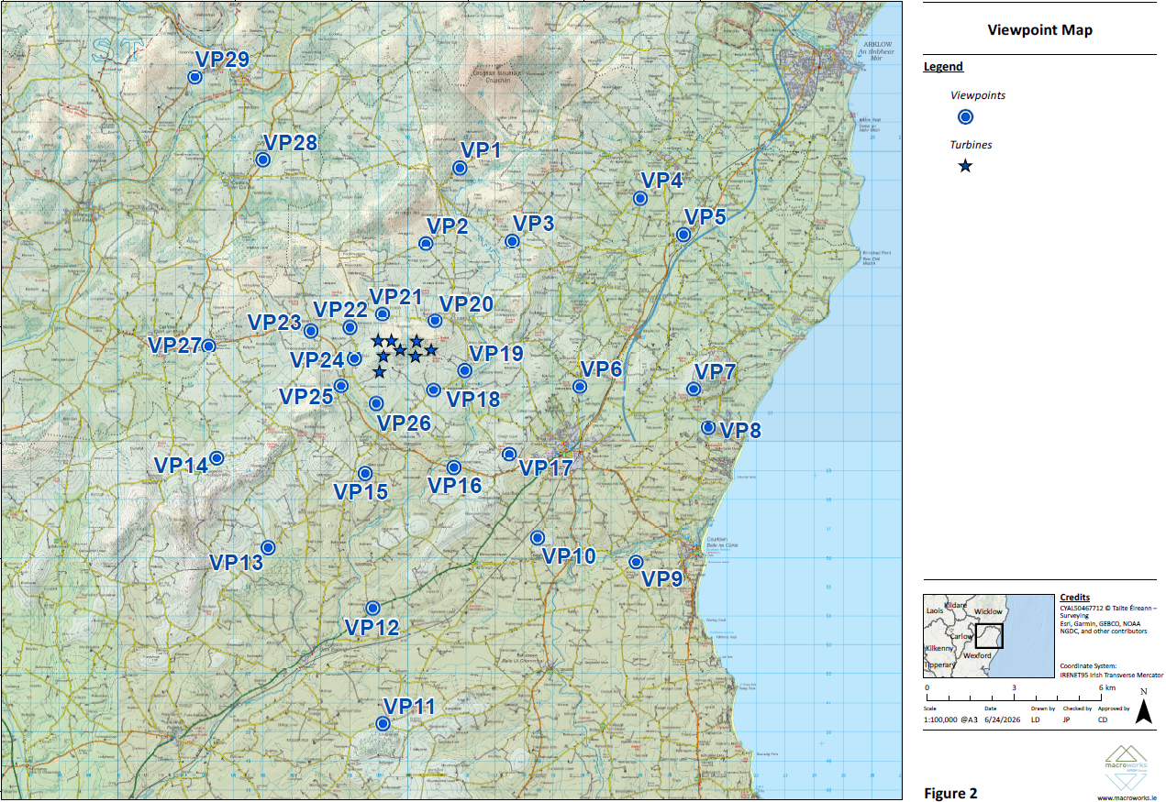
Landscape and Visual
A total of 29 no. viewpoints have been selected – as shown.
We note ACP previous request for consideration of Cultural Heritage and viewpoints to and from archaeological monuments, which will be incorporated.
During the meeting with Wexford County Council, they requested consideration to Arklow Bank Offshore Wind Farm. Approximately 10km off the coast and 20+km from the site.

Slide 9
Archaeology and Cultural Heritage
The proposal (Wind turbines, Grid Connection Route, Blade Transition Area, and Substation) are sufficiently set back from any SMR and ZON.
At a recent meeting with Wexford County Council, the County Heritage Officer requested that an Archaeological Impact Assessment (AIA) is submitted, and Geo-physical Investigations to be undertaken as part of the planning application.
We do not consider Geo-physical Investigations to be appropriate to form part of the planning application and should instead be conditioned to any subsequent planning permission.

Slide 10
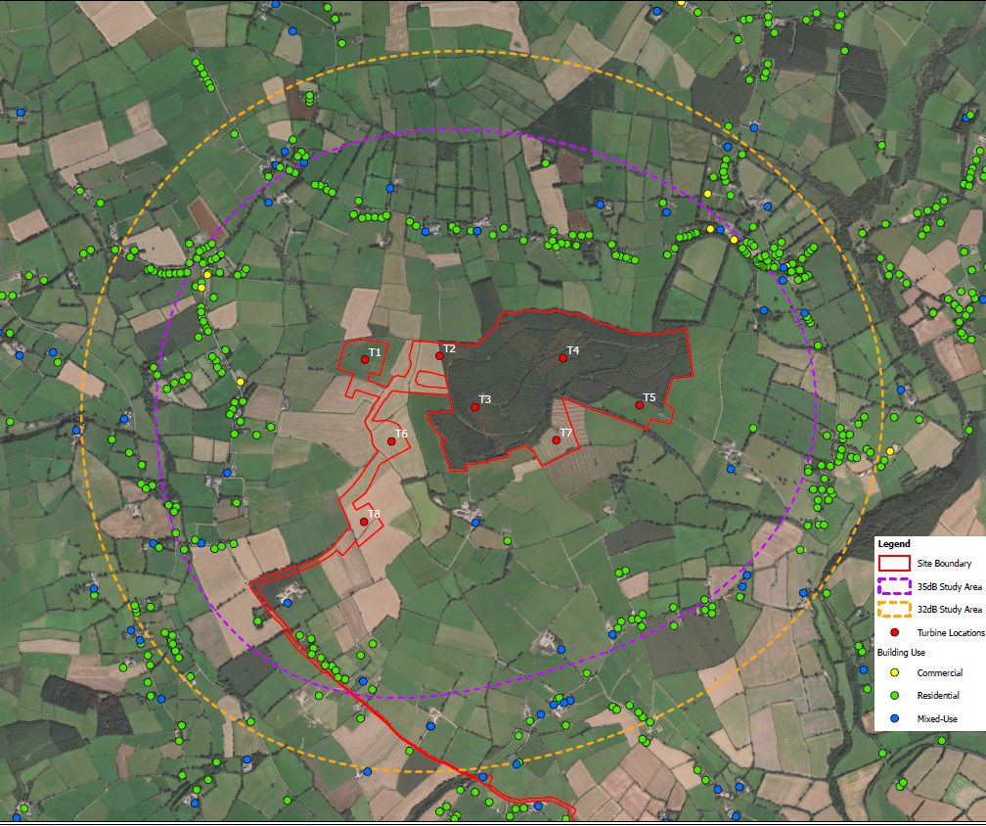
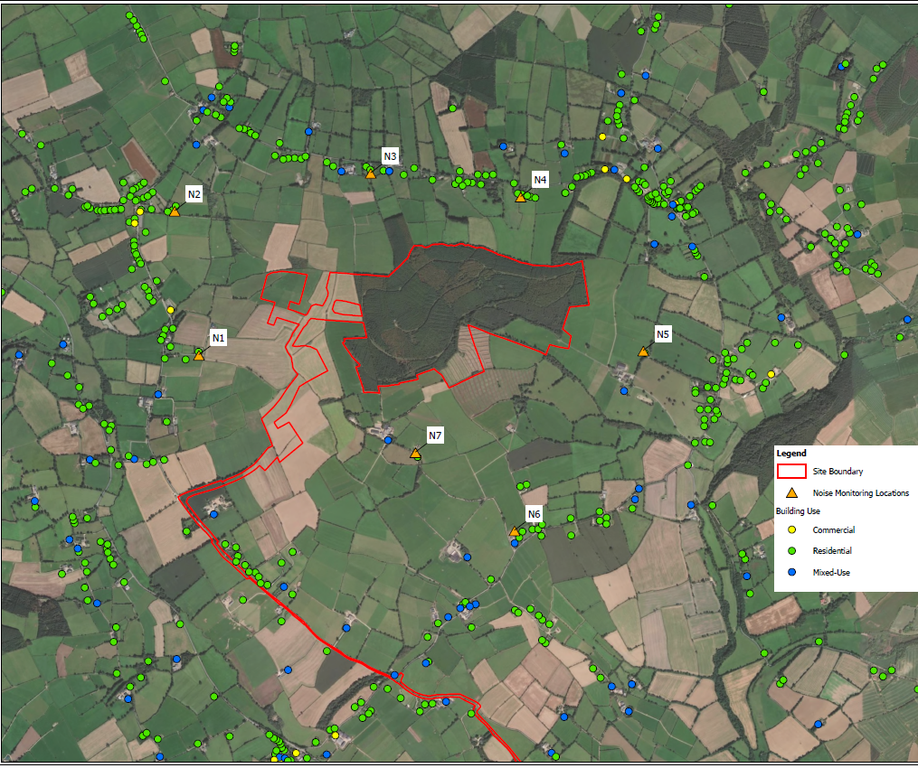
Noise Surveys – Wind Farm
Noise monitoring has been conducted at 7 no. locations in vicinity of the Wind Farm site to develop noise limits under Wind Energy Design Guidelines 2006 in October/November 2025.
Windfarm Night time 43 dB limit exceeded at a single location (south and central: Eircode Y25 NF22 – blue dot south of T3). Some marginal exceedance of day time limits occurs at properties, south, west and north of the proposed windfarm therefore curtailment would likely be proposed.

Slide 11
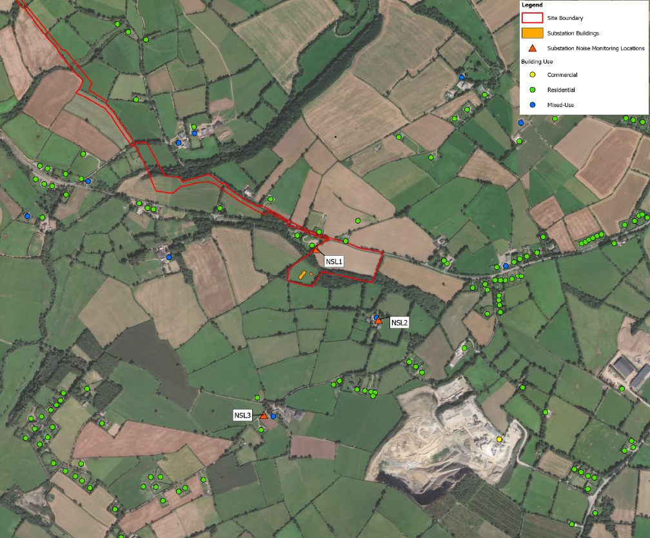
Noise Surveys - Substation
Noise monitoring has been conducted at noise sensitive locations near the substation in August 2025.
Substation is also assessed based on current guidance (Using BS4142 Methods for rating and assessing industrial and commercial sound and Environmental Protection Agency NG4 Criteria).

Slide 12
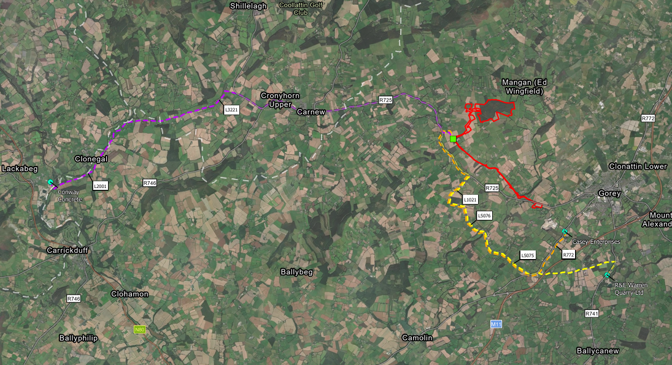
Other Material Assets
Entrance details to the Wind Farm site and Substation/Blade Transition Lands are in line with Wexford Policy Requirements (Vis splays - 65m and 3m back).
Currently undertaking cut and fill calculations for the proposal, and this will feed into the Haul Route Assessment. A total of 3 no. Haul Routes have been identified.
Shadow Flicker will be provided by technical note, as opposed to a standalone chapter.

Slide 13
Consultation
Undertook a pre-application consultation meeting with Wexford County Council on Thursday (18th) of last week.
EIA Informal Scoping is currently ongoing.

